Slide 1


A Presentation on
Cloud Cryptography
Under Supervision of –
Prof. UMA SESHADRI
Presented By -
Pankaj Kumar
17BCS036

Slide 2

Cryptography in Cloud Framework

Slide 3
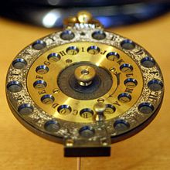
What is Cryptography?
Cryptography or Cryptology is the practice and study of hiding information.
The art of protecting information by transforming it (encrypting it) into an unreadable format, called cipher text.
Only those who possess a secret key can decipher (or decrypt) the message into plain text.
Both sender and receiver are provided with keys to encrypt and decrypt the message.

Slide 4
Virtualization Structure of Cloud Encrypt Machine
Cryptography cloud provides consumers with secure and reliable cryptography services.
VCM is a complete cipher machine system that is a software-simulated system with functions same as hardware encrypt system, and which runs in a completely isolated environment.
Cloud cipher machine supports hardware virtualization technology, which transforms the traditional crypto device into a cloud crypto device that supports deployment in cloud.
The devices in the underlying hardware system, such as CPU, memory, network device and crypto card, are logically divided into multiple virtual Units, such as vCPU, virtual memory, virtual crypto card (vCC) and so on.

Slide 5
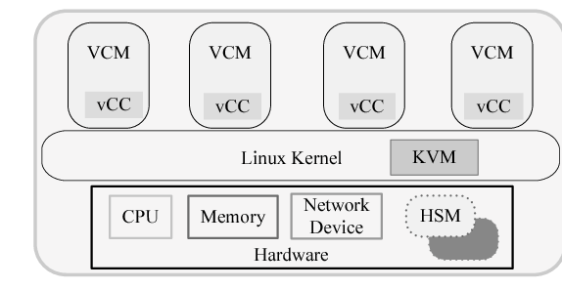
KVM(Kernel-based Virtual Machine) manages and organizes cloud cryptography functions using VCM as service carrier.
Crypto card provides shareable cryptography resources based on single-root I/O virtualization (SR-IOV), and the SR-IOV standard allows efficient sharing of PCIe (peripheral component interconnect express) devices between VCMs.
VCMs are isolated from each other and have completely isolated key systems and spaces.
To ensure total security all cryptography operations are ultimately completed by crypto cards, besides, plaintext keys only appear in hardware.

Slide 6

Design of CC Framework

Slide 7
General Framework
Cryptography service system in cloud environment that provides cryptography service with cloud computing mode is called CC.
CC provides cloud users with three types of cloud cryptography services, there are cryptography components based on network, cryptography middleware, and cryptography application system.
The infrastructure of cryptography cloud is a cluster of cloud cipher machines to form a cryptography computing centre (CCC).
The management of consumer identities, keys and tasks on CC are responsible for the corresponding function modules, and the unified management and monitoring of underlying cryptography equipment are achieved through modular way.

Slide 8
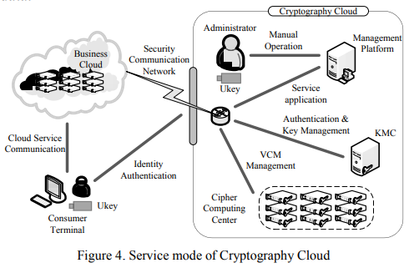
Cryptography cloud is a security service centre of cloud computing system for cloud users with a variety of password technology services such as digital signatures, public key cryptography and symmetric encryption technology.
Cryptography algorithm is actualized by the way of underlying hardware programming. The management and storage of keys come true by accessing control to trusted root key and strategies that master-slave key authorization.
The network communication among modules of the CC is protected by encryption channel with TLS1.2, The communication between service cloud and cryptography cloud adopts the network security transmission strategy based on the idea of software-defined security

Slide 9
Function analysis of modules
Cryptography cloud is divided into three parts, namely management platform of CC, key management centre and CCC.
the management platform consists of VCM management scheduler, monitor of cloud cipher machine, network manager and authentication module, and the main function of it is operational decision-making, authentication and subnet management.
Key management centre is composed by certification authority module and keys escrow subsystem, mainly responsible for the authentication to user identity, system management platform and VCM instance as well as DEK (Database Encryption Key) management.

Slide 10
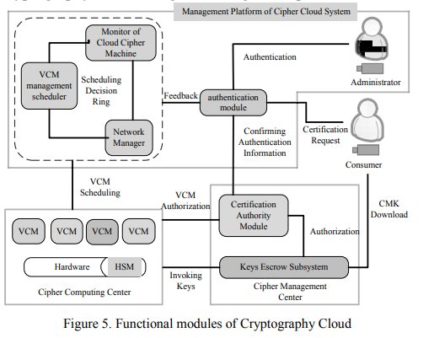
The functional structure diagram, indicating the relationship among sub-modules.
VCM management scheduler, monitor of cloud cipher machines and network manager form a scheduling decision ring, and after collecting and processing system information, a schedule and decision about the VCM and related keys will be formed, as well as security isolation strategy between virtual subnets.
The authentication module is the authentication agent of
certification authority module belongs to key management
centre. And it transmits authentication request and result of
consumers in the management platform of system.
it is also responsible for initiating authentication request
of the virtual subnet to certification authority module and
result feedback.
Besides the request information of the authentication
agent, certification authority module is also responsible for
authorizing VCM instances and related keys of consumers.
The main function of key escrow subsystem is to store
and distribute encrypted DEK

Slide 11
Design of cryptography service flow
The diagram illustrates the working mechanism of CC when consumers invoke cryptography service.
The consumer-oriented service processes of CC can be divided into two phases-
Phase one is the authentication and system services preparation
Phase two is the management and scheduling of cryptography service.

Slide 12
The consumer-oriented service processes of CC can be described as follows:
When USB key (Ukey) equipped with CMK is inserted into one terminal, it initiates an authentication request to the authentication module.
The authentication module forwards authentication information of consumer to certification authority module of key management centre. After consumer identity is confirmed correctly, the identity confirmation will be fed back to authentication module.
After the authentication module receives confirmation message, it immediately sets mark that ordering encrypted CMK to be downloaded on the terminal and waits for key escrow subsystem to apply for that CMK. Meanwhile, VCM management scheduler is notified to join VCM of consumer to the dispatch queue list, and inform the network manager to set a security domain for the consumer.
The network manager uploads new network deployment information to the monitor module, while VCM management scheduler updates the security domain management strategy according to new monitoring information, and then deploys VCMs in the CCC.

Slide 13
When VCM instance is generated and enabled, VCM entity applies for authentication to the certification authority module. And when verifying that the VCM instance has successfully authenticated, the certification authority module sends back the result to the VCM instance and sends key authorization signal to key escrow subsystem.
Key escrow subsystem sends CMK download signal to the terminal, only when it is matching with CMK download mark, ciphertext CMK in the Ukey can be downloaded to the key escrow subsystem. And plaintext CMK encrypted by root key is used as the secondary key to encrypt DEK, besides, DEK protected by root key can be obtained.
When VCM invokes keys to provide cryptography service for business cloud, VCM instance that authenticated by certification authority module can directly send a key transfer request to key escrow subsystem. And after receiving key transfer feedback, the related DEK would be downloaded through secure communication channel to execute cryptography service.
VCM provides the cryptography service, meanwhile, the monitor continuously collects the status information about VCM, cloud cipher machines and network, to help the final decision through making statistics and calculations on the information.
VCM management scheduler makes a schedule plan about VCM instances to deploy in CCC according to monitoring information and scheduling strategy.

Slide 14
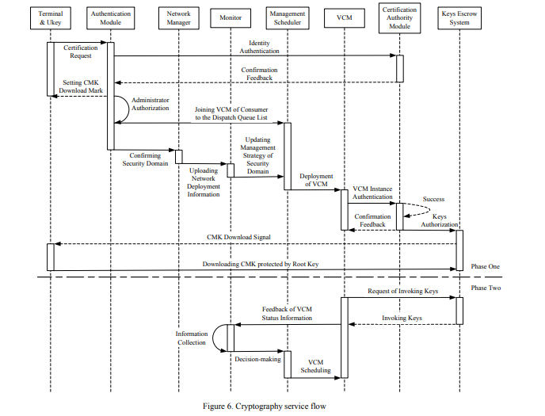

Slide 15


